Slide 1
Storage basics

Slide 2
Supporting technologies
Solid state storage
Upcoming & gaining popularity
Gives excellent performance for random read workload
Electro-magnetic storage
Existing for over 50 years
Excellent performance for sequential work load
400 MBps : 250 Mbps for 15 K RPM Disk

Slide 3
Storage Devices
Disk storage :
Solid State storage
Tape storage
Hybrid Disk

Slide 4
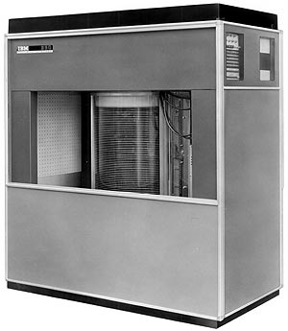
IBM RAMAC 350 disk
Developed in 1956
Height 66 inches
50 platters of size 24 inches
Weight : around 1 ton
Storage capacity : 4MB

Slide 5
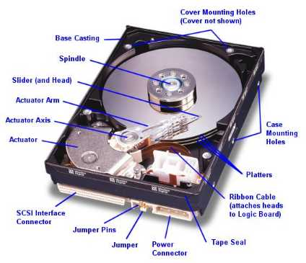

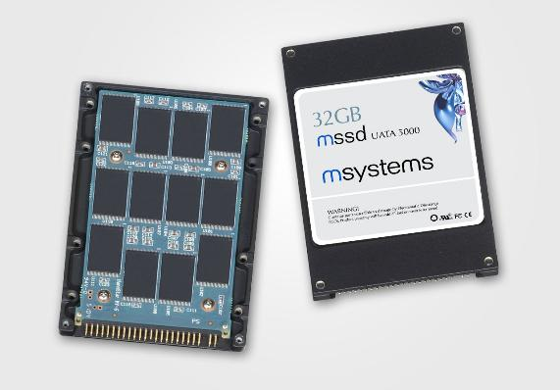
Mass Storage: HDD and SSD
Most popular: Magnetic hard disk drives
Solid state drives: (SSD)

Slide 6
Modern Disk Drives
Mechanism
Recording Components
Rotating Disk
Heads
Positioning Components
Arm Assembly
Track-following System
Controller
Microprocessor
Buffer Memory
Interface to SCSI bus

Slide 7
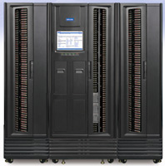
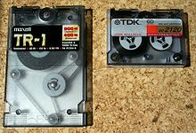
Magnetic Tape
Relatively permanent and holds large quantities of data
1000 times slower than disk
Mainly used for backup, storage of infrequently-used data, transfer medium between systems
20-1.5TB typical storage
Common technologies are 4mm, 8mm, 19mm, LTO-2 and SDLT
the original version of which was released in 2000 and can hold 100 GB of data
The seventh generation of LTO Ultrium was released in 2015 and can hold 6.0 TB

Slide 8
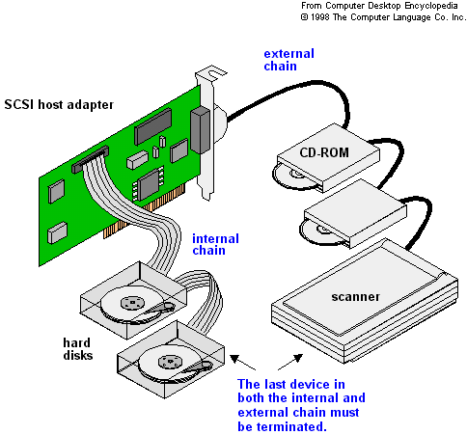
Disk Attachment
Drive attached to computer via I/O bus
USB
SATA (replacing ATA, PATA, EIDE)
SCSI
itself is a bus, up to 16 devices on one cable, SCSI initiator requests operation and SCSI targets perform tasks
FC (Fiber Channel) is high-speed serial architecture
Can be switched fabric with 24-bit address space – the basis of storage area networks (SANs) in which many hosts attach to many storage units
Can be arbitrated loop (FC-AL) of 126 devices

Slide 9
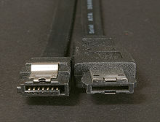
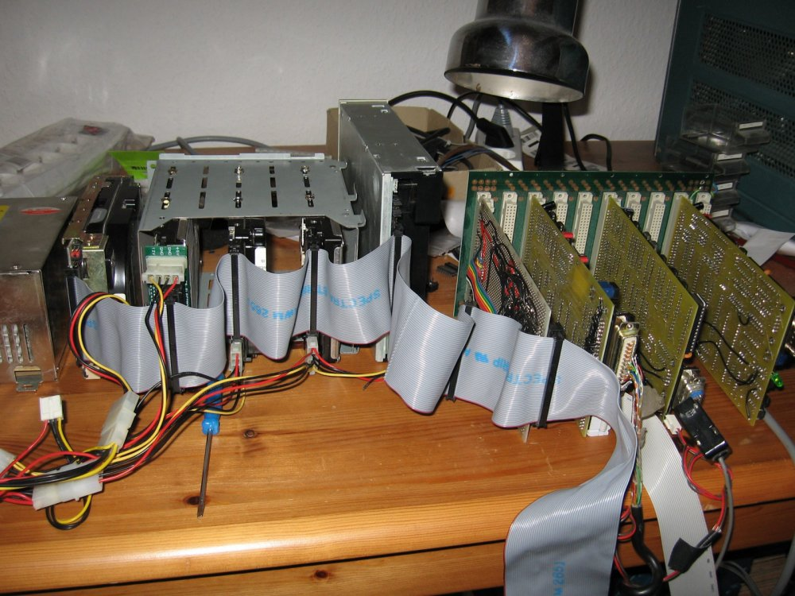
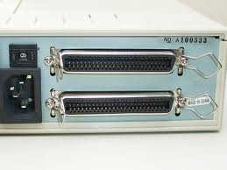
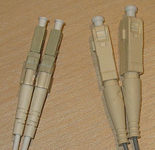
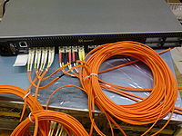
SATA connectors
SCSI
FC with SAN-switch

Slide 10
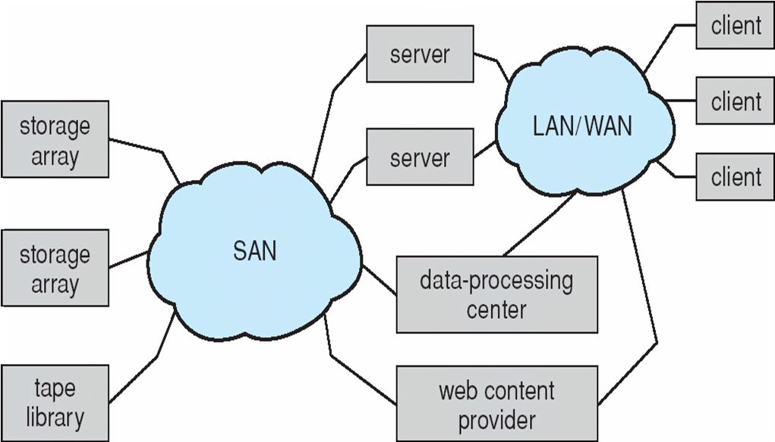
Storage Area Network (SAN)
Special/dedicated network for accessing block level data storage
Multiple hosts attached to multiple storage arrays - flexible

Slide 11
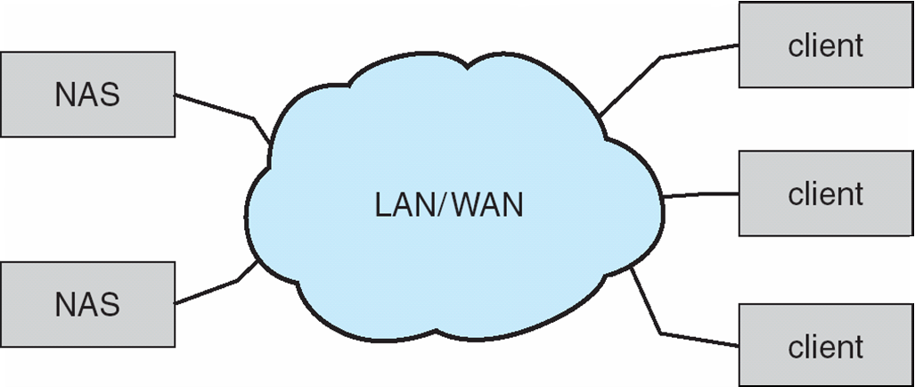
Network-Attached Storage
Network-attached storage (NAS) is storage made available over a network rather than over a local connection (such as a bus)
NFS and CIFS are common protocols
Implemented via remote procedure calls (RPCs) between host and storage
New iSCSI protocol uses IP network to carry the SCSI protocol

Slide 12
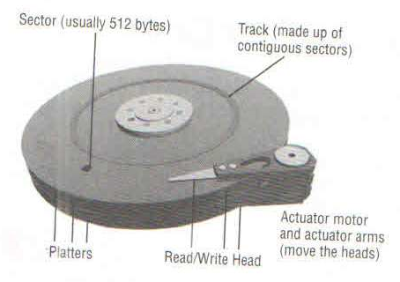
Anatomy of Disk
Major components of disk drives
Platters
Read write head
Actuator assembly
Spindle motor

Slide 13
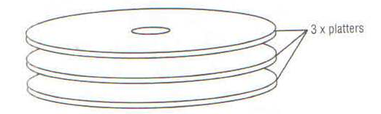
Platter
Are made up of glass or aluminum substrate
Is coated with material
It is rigid, thin, flat , smooth
All platters are attached to common shaft (spindle)
Rigidity & smoothness is very important . Any defect could result in head crash

Slide 14
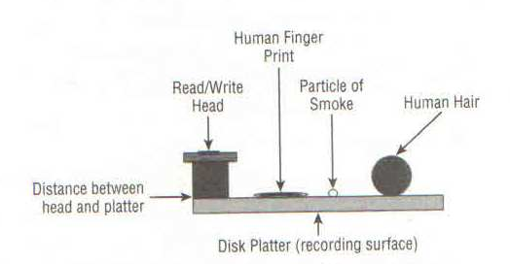
Read Write head
Head flies above the platter surface
Attached to actuator assembly
OS does not know any thing about read write head
Flying hight is measured in micrometers

Slide 15
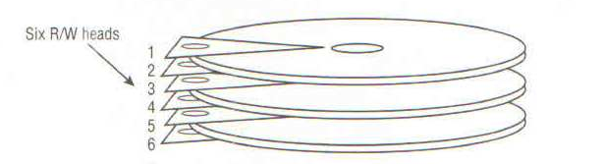
Head crash
Read /write head never touch platter. If they touch , it is known as head crash.
Head crash would always result in complete loss of data .
Each platter surface has its own read/write head
Concept ohead and recording surface gave rise to CSH addressing

Slide 16
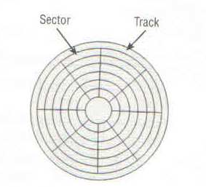
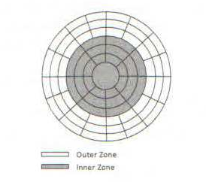
Tracks & Sectors
Surface of every platter is microscopically divided into tracks & sectors
Sector is the smallest addressible unit of a disk drive
Sector size is typically 512 bytes or 520 bytes
SATA (Serial Advance Technology Attachment) have fixed sector size of 512 bytes
FC ( Fiber channel ) and serial attached SCSI ( SAS) drives can be arbitrarily formatted to different size
This is important for implementation of data integrity technology for Endo to end data protection EDP
Read T10 DIF
8 bytes of data added to end of every 512 byte sector
This allows errors to be detected

Slide 17
Tracks & Sectors
Size of each sector is getting smaller and smaller towards the center .
The recording density being same , outer sectors waste space
Most modern disk implement Zoned Data Recording ( ZDR)
The outer track store and retrieve more data per spin
If data is read or written to contiguous sector of same or adjacent track we get better performance
Short stroking to achieve performance
Data could be stored only on outermost tracks
Reduced capacity , reduced load

Slide 18
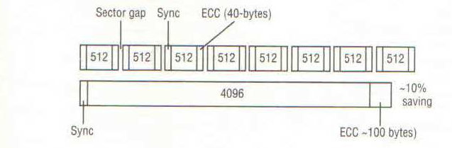
Larger sector size trend
512 byte sector requires 320 bytes for ECC
4K byte requires only 100 byte
Type of disk where size of sector is fixed and can not be changed is known as Fixed Block Architecture ( FBA)

Slide 19
Logical block addressing
Hides complexity of CSH based addressing
Is complex due to ZDR
Bad sector handling mechanism
LBA is implemented in drive controller
LBA to PBA mapping is required
OS or volume managers never know the precise location of the data on disk

Slide 20
Actuator & Spindle
Actuators are responsible for head movement .
All the heads are connected to single actuator they move at same time
All platters are mounted on single spindle
Each platter move at same speed

Slide 21
Controller
Each disk drive comes with its own controller
Controller has a processor, memory and it runs firmware
Controller hides the disk operation complexities
It maps Physical address to logical address and exposes LBA to OS/ Bios
Controller also monitors the health of disk
It also maintains the bad block map
Each drive has a number of hidden / spare block which are used to remap bad blocks

Slide 22
Interface & protocols
Protocol is set of command and rules of communication
Disk drives , Solid state media follow a protocol
In storage domain protocols also define
Physical interface specification
Command sets

Slide 23
Common protocol & interfaces
Serial advance technology attachment (SATA)
Serial attached SCSI (SAS)
Nearline SAS ( NLSAS)
Fibre channel ( FC)

Slide 24
Serial advance technology attachment (SATA)
Low end computing , cheap, low performance, use low cost components, smaller buffer etc.
Used at lower tier of auto tiering (is the automated progression or demotion of data across different tiers of storage device ) solution

Slide 25
Serial attached SCSI (SAS)
Serial Point to point protocol
Uses SCSI command set
SAS drives are more expensive than SATA and offer better performance than SATA
Used for high end applications
SAS drives are dual ported and each port can be connected to different controller resulting in higher performance and reliability
FC drives implement SCSI command set but have dual FC-AL or dual FC Point to point interface
NL –SAS are hybrid of SAS and SATA
It has SAS interface , follows SAS protocol but uses SATA disk platters and components

Slide 26
Queing
All disk drive implement queuing
SATA implements Native Command Queuing (NCQ)
SCSI uses command tag queuing

Slide 27
HDD Form factor
Form factor | Hight | Width | Depth
3.5 inch | 1 inch | 4 inch | 5.75 inch
2.5 inch | 0.6 inch | 2.75 inch | 3.94 inch

Slide 28
Drive speed
5400 RPM
7200 RPM
10000RPM
15000 RPM ( 240 KM / hr)
Higher RPM better performance
Higher RPM lower the capacity
2.5 inch , 900Gb 10K
3.5 inch , 4 TB 7500RPM

Slide 29
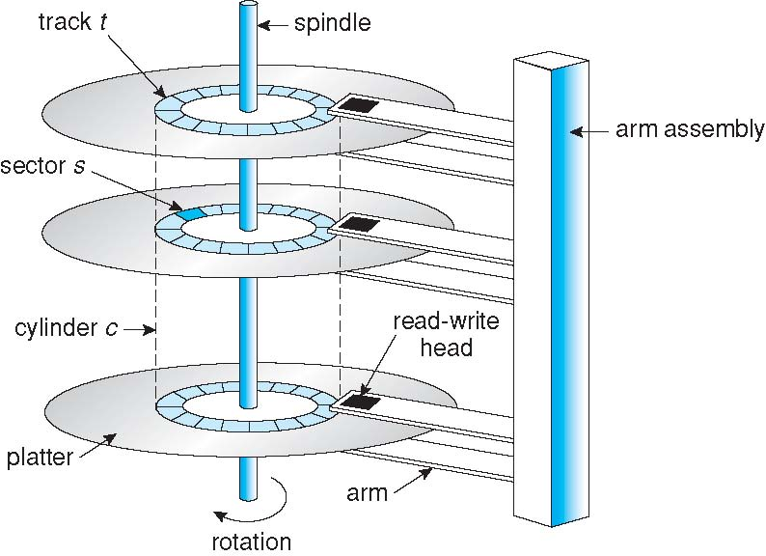
Moving-head Disk Mechanism

Slide 30
Disk performance
Seek time (15k 3.4 to 3.9ms) (7.2K 8.5 to 9.5 ms)
Rotational latency 15k 2ms 7.2k 4.16ms
Transfer time
Access time = seek time+ rot delay + transfer time
IOPS = 1 /(AST+ART) *1000
eg. 1/( 3.2+2)* 1000 = 181
Maximum and sustained data transfer rate
For 15K disks max 600 MBps , 198 MBps

Slide 31
Estimate sustained average transfer rate
Suppose that a disk drive spins at 7200 RPM (revolutions per minute), has a sector size of 512 bytes, and holds 160 sectors per track.
What is sustained average transfer rate of this drive in megabytes per second?
.Disk spins 120 times per second (7200 RPM/60)
Each spin transfers a track of 80 KB (160 sectors x0.5K)
Sustained average transfer rate is 120x80 = 9.6MB/s.

Slide 32
Average performance of random access
7200 RPM, sector size of 512 bytes, and 160 sectors per track.
Average seek time for the drive is 8 milliseconds
Estimate # of random sector I/Os per second that can be done and the effective average transfer rate for random-access of a sector?
Disk spins 120 times per second
Average rotational cost is time to travel half track: 1/120 * 50%=4.167ms
Transfer time is = 8ms to seek
+ 4.167 ms rotational latency
+ 0.052 ms (reading one sector takes 0.0005MB/ 9.6MB).
=12.219ms
# of random sector access/second= 1/0.012219=81.8
Effective transferring rate: 0.5 KB/0.012.219s=0.0409MB/s.

Slide 33
Disk Scheduling: Objective
Given a set of IO requests
Coordinate disk access of multiple I/O requests for faster performance and reduced seek time.
Seek time ≈ seek distance
Measured by total head movement in terms of cylinders from one request to another.
Hard Disk
Drive

Slide 34
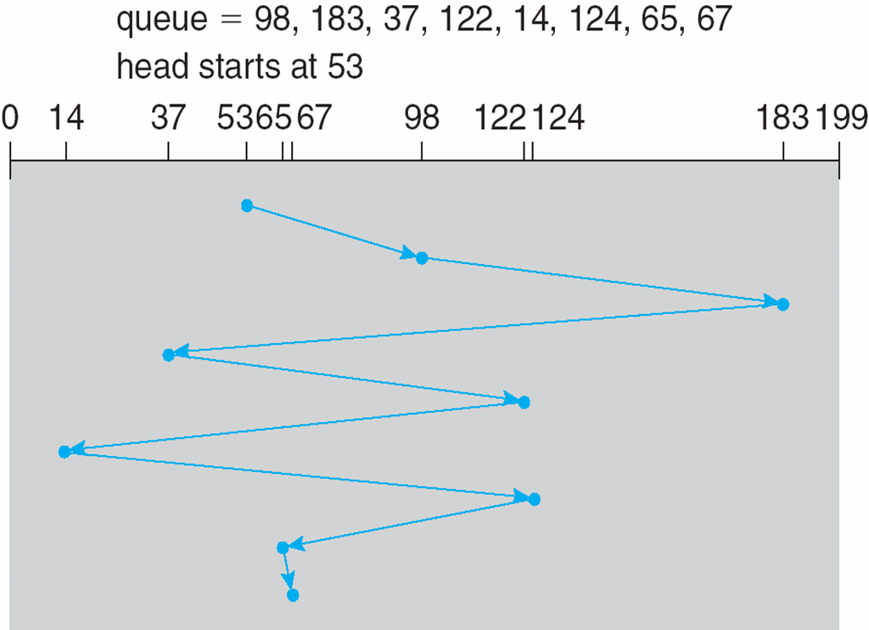
FCFS (First Come First Serve)
total head movement: 640 cylinders for executing all requests

Slide 35
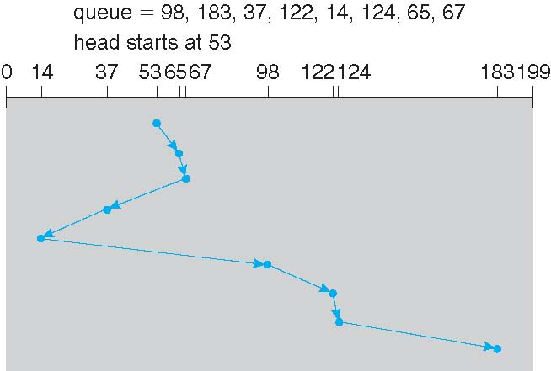
SSTF (Shortest Seek Time First)
Selects the request with the minimum seek time from the current head position
total head movement: 236 cylinders

Slide 36
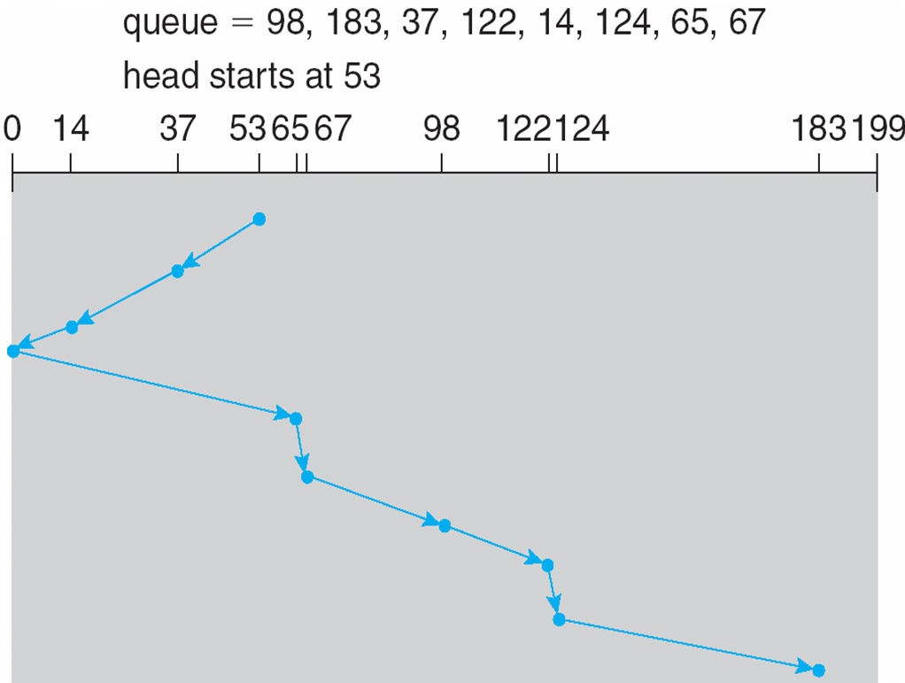
SCAN: Elevator algorithm
The disk arm starts at one end of the disk, and moves toward the other end, servicing requests until it gets to the other end of the disk, where the head movement is reversed and servicing continues.
total head movement : 208 cylinders

Slide 37
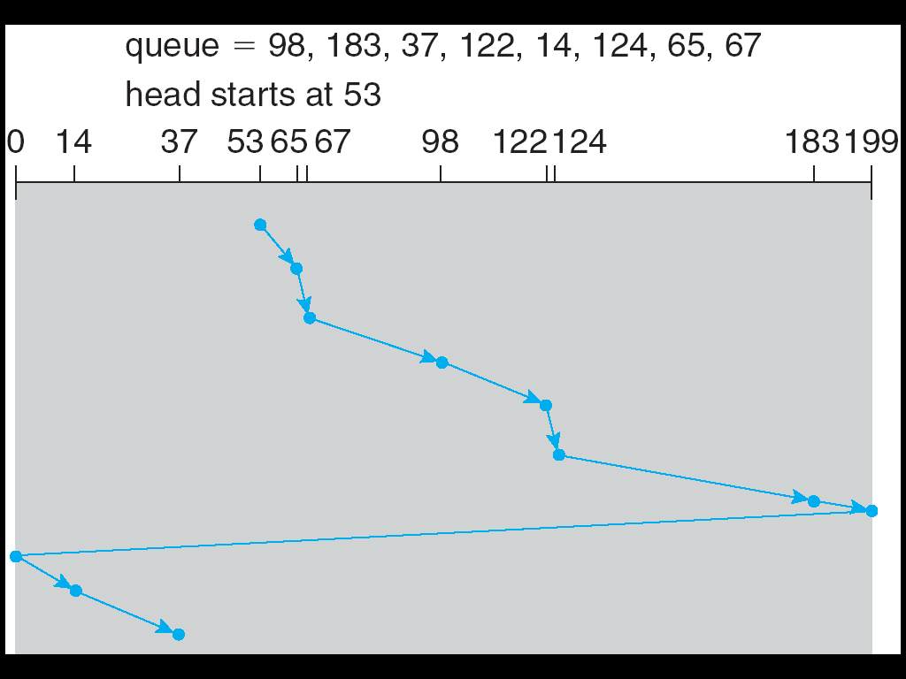
C-SCAN (Circular-SCAN)
Provides a more uniform wait time than SCAN by treating cylinders as a circular list.
The head moves from one end of the disk to the other, servicing requests as it goes. When it reaches the other end, it immediately returns to the beginning of the disk, without servicing any requests on the return trip

Slide 38
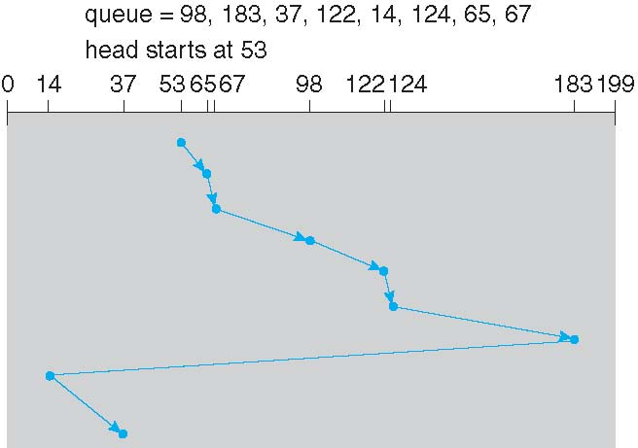
C-LOOK: A version of C-Scan
Arm only goes as far as the last request in each direction, then reverses direction immediately, without first going all the way to the end of the disk

Slide 39
Scheduling Algorithms
Algorithm Name | Description
FCFS | First-come first-served
SSTF | Shortest seek time first; process the request that reduces next seek time
SCAN (aka Elevator) | Move head from end to end (has a current direction)
C-SCAN | Only service requests in one direction (circular SCAN)
LOOK | Similar to SCAN, but donot go all the way to the end of the disk.
C-LOOK | Circular LOOK. Similar to C-SCAN, but donot go all the way to the end of the disk.
Notes:
SCAN (dumb elevator): Back and forth, to end/start track
C-: Circular: Only process requests in one direction
LOOK: Only go as far as last request

Slide 40
Swap-Space Management
Swap-space — Virtual memory uses disk space as an extension of main memory
Swap-space can be carved out of the normal file system, or, more commonly, it can be in a separate disk partition
Swap-space management
Allocate swap space when process starts; holds text segment (the program) and data segment
Kernel uses swap maps to track swap-space use

Slide 41
Solid state Media
It comes in same shape and size as of HDD
It supports SATA, SAS & FC interface
PCI Card / solid state card , it is solid state media in form of PCI expansion card
It is used in high end storage arrays for as level 2 cache
It has no mechanical parts
It gives excellent performance for random work load
More predictable performance as compared to disk as has no positional latency
Requires less power
It is expensive
For Random reads SSD gives similar performance as DRAM

Slide 42
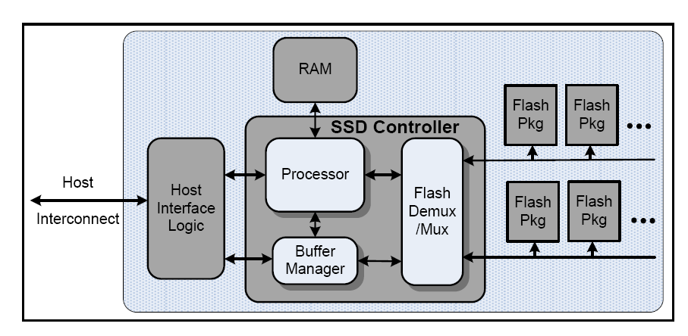
SSD Logic Components

Slide 43
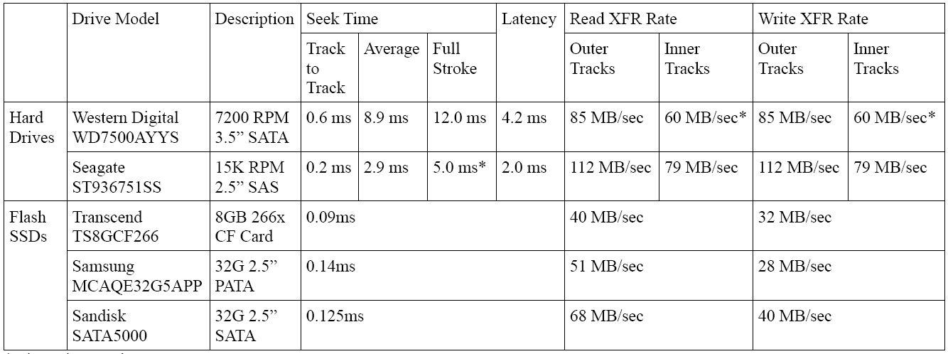
Typical read and write rates

Slide 44
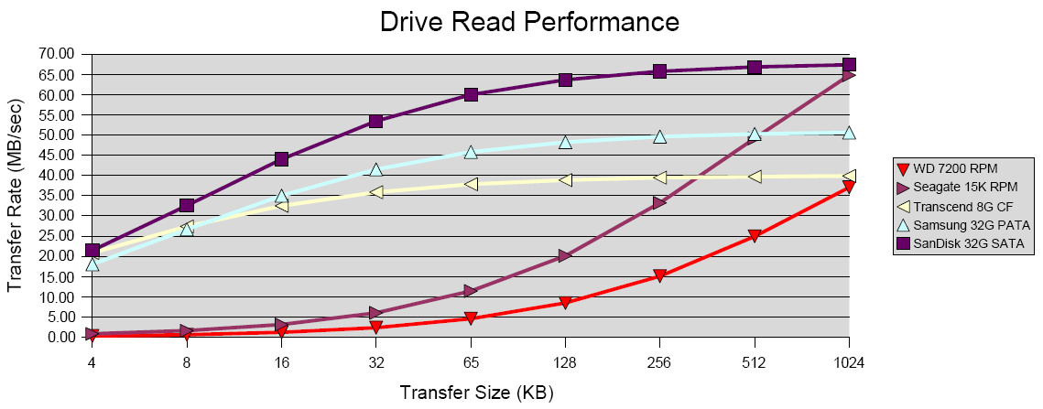
Drive read performance

Slide 45
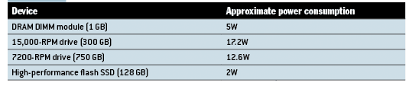
Power consumption

Slide 46
Flash Memory
Two Types
NAND flash ( Most widely used)
Designed with small cell size
Has low cost –per –bit for stored data
Used as high density medium for consumer device
Program erase cycle ( PE cycle ) 100000
NOR Flash
is typically used for storing code and direct execution in portable electronic devices
Nor is typically slow on write and consume more power than nand
NOR is fast on read and consumes less power

Slide 47
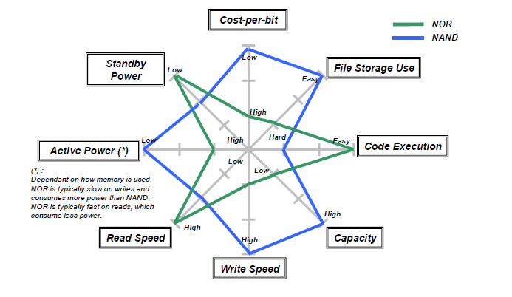
Comparison of NOR & NAND flash

Slide 48
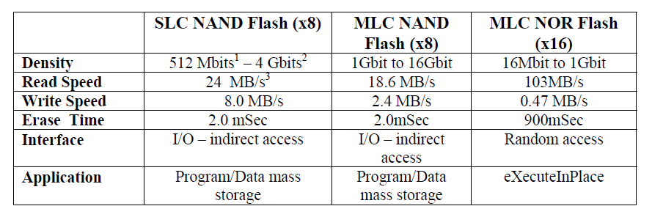

Slide 49
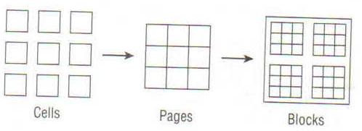
Anatomy of Flash memory
Flash memory is made up of flash cell
Cells are grouped into pages (4K, 8K, 16K etc)
Pages are grouped into blocks (128 K, 256 K 512 K)

Slide 50
Writing to flash memory
New flash comes with all cells set to 1
Flash cells can be programmed from one to zero
To convert to zero to one erase operation is to be performed
Erasing can only be done at block level
First time write performance is very fast
If any part of flash memory block has been written alll subsequent write to any part will take via read –erase – write operation

Slide 51
Types of NAND Flash
Single Level cell (SLC)
can store one bit of data
Highest performance
lowest density
Expensive
Multi level cell
Stores two bit of data per cell
Lower PE cycle 10000
Read about eMLC
It stores 2 bit per cell by applying different level of voltage
Triple Level cell

Slide 52
Garbage Collection
Block that is marked for deletion
Block that are sparsely filled ( can be combined into fewer block )
Write amplification
When number of write to media is greater than number of write issued by host
Write amplification slows flash performance and wears out flash cell
Wear leveling : is process of distributing the work load across all flash cell.
Background wear leveling
In-flight wear leveling

Slide 53
Caching in SSD
It improves performance
Extends the life of media
Write coalescing : is process of holding write in cache , untill page or block can be writen
Write combining : when a particular LBA is written over and over again

Slide 54
Cost of flash & SSD
$/GB cost for Flash is higher than $/GB cost for HDD
$/ I/O Operation
SSD costing $10000 provides 25000 IOPS resulting into $.4/ I/O operation
600GB disk drive costing $ 2000 provides 200 IOPS resulting into $10 / I/O operation
If we need to provide 25000 IOPS, we need 125 drives . These drives will require power, cooling

Slide 55

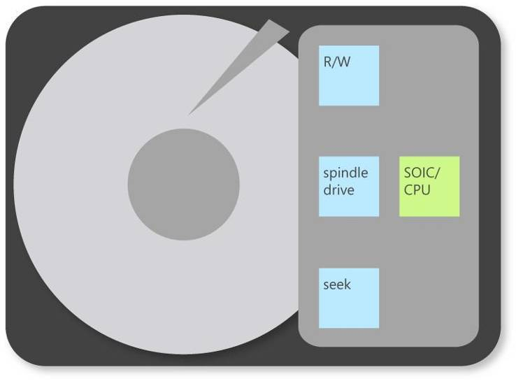
Hybrid Disk Drive
A hybrid disk uses a small SSD as a buffer for a larger drive
All dirty blocks can be flushed to the actual hard drive based on:
Time, Threshold, Loss of power/computer shutdown
Dram
Cache
ATA Interface
Add a non-volatile cache
NV
Cache

Slide 56
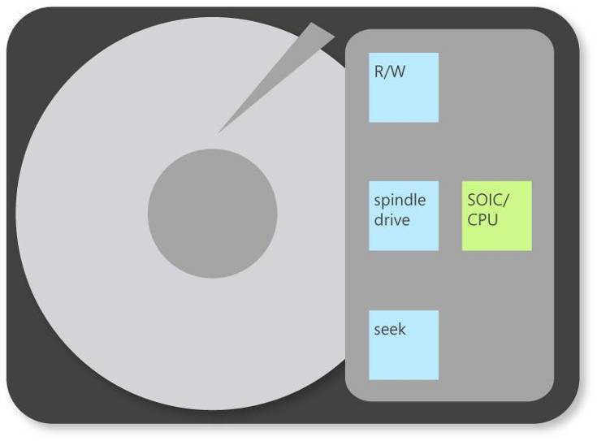
Hybrid Disk Drive Benefits
Dram
Cache
Up to 90% Power Saving
when powered down
ATA Interface
Read and Write instantly while spindle stopped
NV
Cache

Slide 57

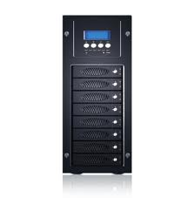
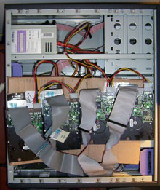
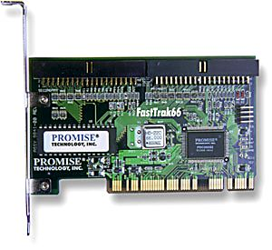
RAID (Redundant Array of Inexpensive Disks)
Multiple disk drives provide reliability
via redundancy.
Increases the mean time to failure
Hardware RAID with RAID controller
vs software RAID

Slide 58
RAID (Cont.)
RAID
multiple disks work cooperatively
Improve reliability by storing redundant data
Improve performance with disk striping (use a group of disks as one storage unit)
RAID is arranged into six different levels
Mirroring (RAID 1) keeps duplicate of each disk
Striped mirrors (RAID 1+0) or mirrored stripes (RAID 0+1) provides high performance and high reliability
Block interleaved parity (RAID 4, 5, 6) uses much less redundancy

Slide 59
RAID (Cont. )
RAID has two main goal
Increase performance by striping
Distributes data over several hard disk thus distributes the load
Increase fault tolerance by redundancy

Slide 60
Storage Virtualization using RAID
RAID controller combines the Physical hard disk to create Virtual hard disk resulting into larger capacity, & less device address
Server connected to a RAID system sees only Virtual hard disk
Controller can distribute data to physical disk in different manner resulting into different RAID levels
If Physical hard disk fails, RAID controller constructs the data from remaining hard disk
RAID controllers can manage common pool of hot spare for several Virtual RAID disk

Slide 61
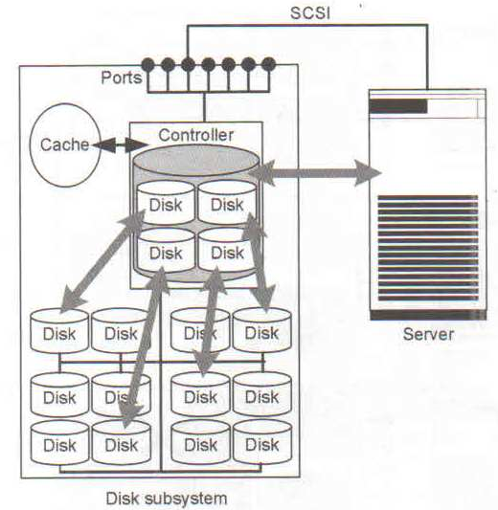

Slide 62
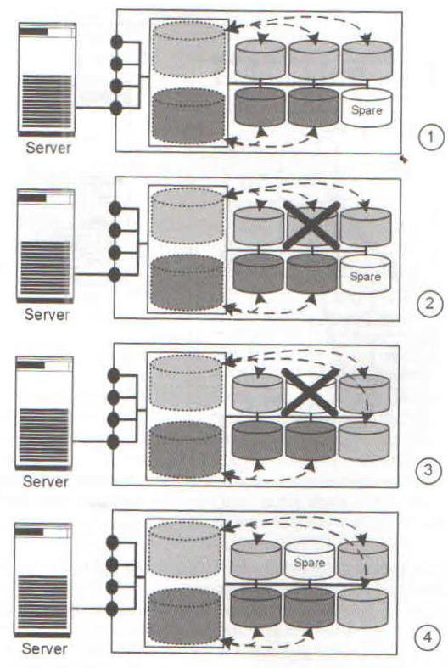

Slide 63
Raid Level 0
Level 0 is non redundant disk array
Block level striping
Files are striped across disks, no redundant info
High read throughput
Best write throughput (no redundant info to write)
Any disk failure results in data loss

Slide 64
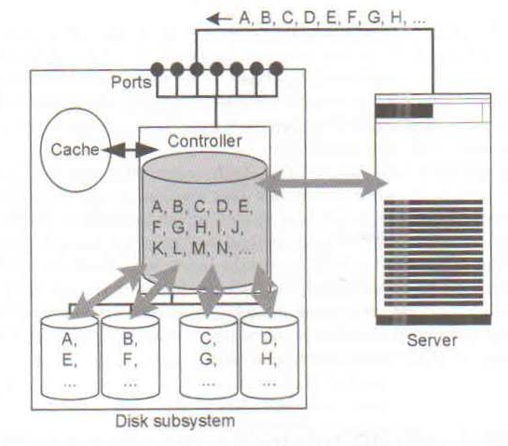
RAID 0

Slide 65
Raid Level 1
Mirrored Disks
Block by block mirroring
Data is written to two places
On failure, just use surviving disk and easy to rebuild
On read, choose fastest to read
Write performance is same as single drive, read performance is 2x better
Expensive
(high space overhead)

Slide 66
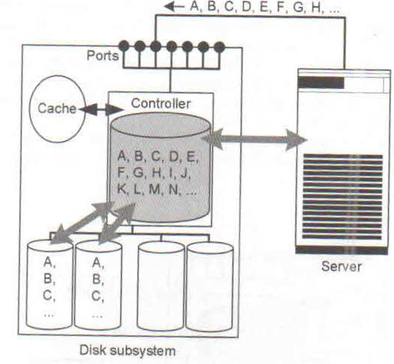

Slide 67
RAID 0+1(Stripping & mirroring) & RAID 1+0 (Mirror & striping )
RAID 0 Increases Performance & RAID 1 increases fault tolerance.
Can We achieve both ?
These Represent Two stage virtualization Hierarchy
In RAID 0+1 stripe & mirror

Slide 68
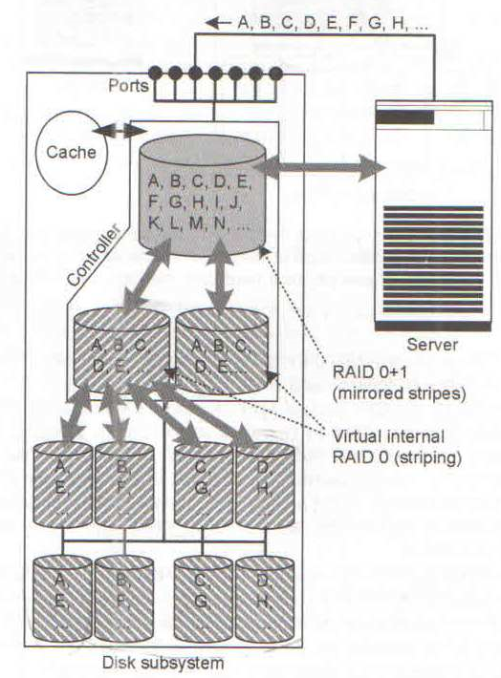

Slide 69
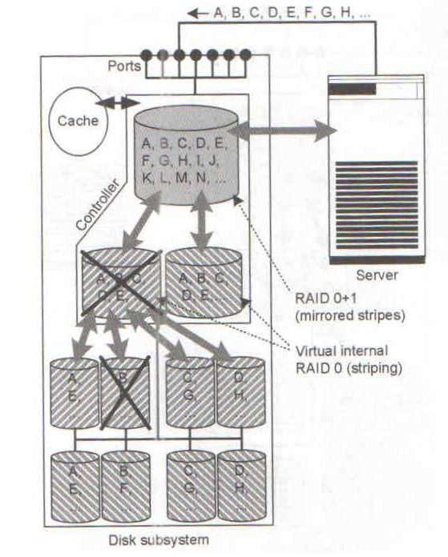

Slide 70
Raid Level 0+1
Stripe on a set of disks
Then mirror of data blocks is striped on the second set.
Stripe 0
Stripe 1
Stripe 2
Stripe 3
Stripe 0
Stripe 1
Stripe 2
Stripe 3
Stripe 4
Stripe 5
Stripe 6
Stripe 7
Stripe 4
Stripe 5
Stripe 6
Stripe 7
Stripe 8
Stripe 9
Stripe 8
Stripe 9
data disks
mirror copies

Slide 71
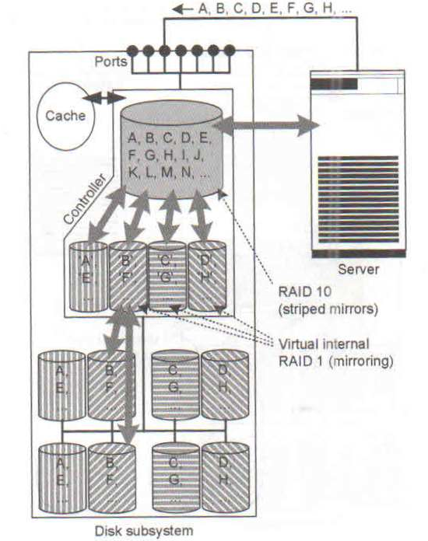
RAID 10

Slide 72
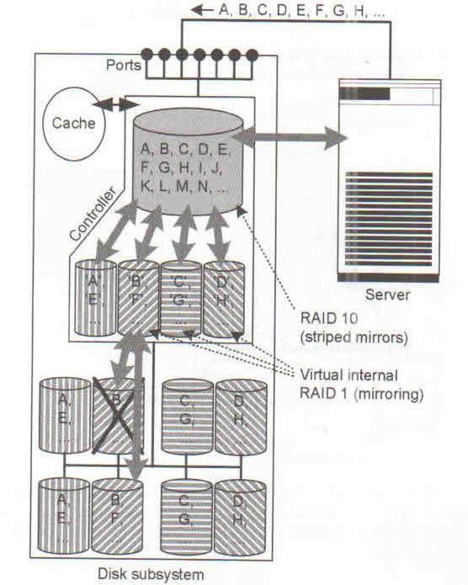

Slide 73
Raid Level 1+0
Pair mirrors first.
Then stripe on a set of paired mirrors
Better reliability than RAID 0+1
Stripe 0
Stripe 0
Stripe 2
Stripe 2
Stripe 4
Stripe 4
Stripe 6
Stripe 6
Stripe 8
Stripe 8
Stripe 10
Stripe 10
Mirror pair
Stripe 1
Stripe 1
Stripe 3
Stripe 3
Stripe 7
Stripe 7
Stripe 5
Stripe 5
Stripe 11
Stripe 11
Stripe 9
Stripe 9

Slide 74
RAID 2, RAID 3
RAID 2 Uses hamming code for error detection & correction
Uses Log (N) + 1 redundant disk
Uses BIT interleaved Parity
Require synchronized disk access
RAID 2 has no longer any practical significance
RAID 3 uses single parity disk
RAID 3 gives high data transfer & low I/O rate
All disks are involved in read & write operation
RAID 3 does not involve any write penalty

Slide 75
RAID 4 & 5
RAID 4 I uses Block interleaved parity
Independent disk access
High data transfer and high I/O rate possible
P = A B C
If Disk A is lost then Find P A and XOR it on both sides of expression
P P A = A A P B C
RAID 4 Has write penalty

Slide 76
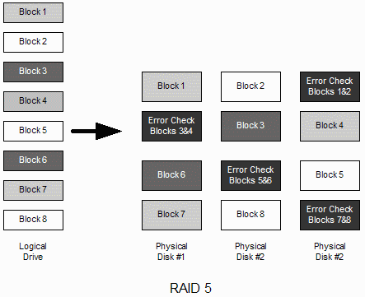
RAID 5

Slide 77
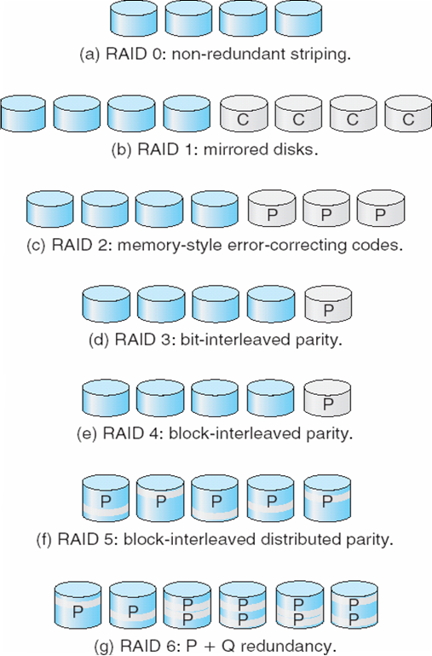
6 RAID Levels

Slide 78
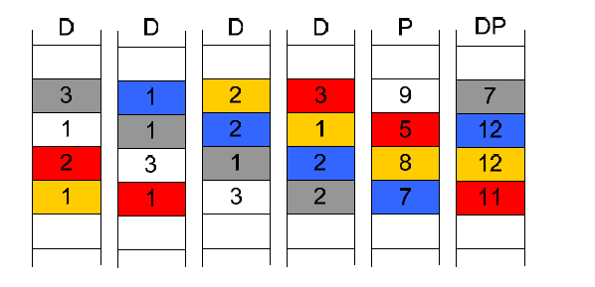
RAID DP

Slide 79
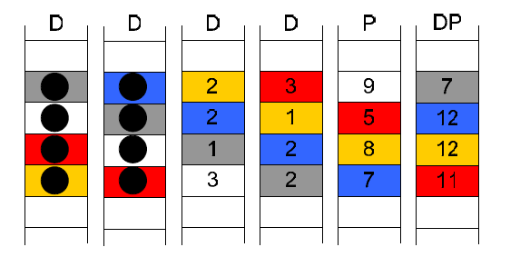
Recovery from failure

Slide 80


Slide 81


Slide 82


Slide 83


Slide 84


Slide 85


Slide 86


Slide 87


Slide 88
Caching
Used by OS to speedup slow operation
In disk subsystems , Caches are designed to accelerate read, write access to physical hard disk
Cache on hard disk
Cache on controller
Read cache
Write cache

Slide 89
Cache on hard disk
Each disk comes with small cache
Transfer rate of I/O channel to disk controller is significantly higher than speed at which disk controller can write to or read from disk
When server / RAID controller writes a block , the disk controller stores it in cache thus freeing the I/O channel
The freed I/O channel can be used for data traffic to other hard disk

Slide 90
Write Cache In controller
The write cache should have a battery backup and ideally be mirrored
Controller buffers all writes into battery backed cache and reports back to app/server write complete
Controller later writes data from cache to slower disk
Read cache is used for pre-fetching

Slide 91
Intelligent disk sub system
These offer additional function over and above RAID eg .
Instant copy
Remote mirroring
LUN masking

Slide 92
Instant copy
Can copy very large data sets within disk subsystem in a few seconds
Instant copies are used for
Generation of test data set
Backup operation
Creating data copies for data mining

Slide 93

Original data
Server 1 works on original data

Slide 94

Copied data
Original data

Slide 95

Copied data
Original data

Slide 96
Implementation Alternative
Data is permanently mirrored
On copy command , mirrors are separated
Separated mirrors can be used independently
After separation of mirror production data is no longer protected against failure
To data protection three way mirror is created

Slide 97
Remote Mirroring
Data copy generated using instant copy does not protect against disk subsystem failure
Remote mirroring provide protection against such failures\
Remote mirroring is handled by two participating subsystem
It is invisible to application server
It requires resources in two disk subsystems and I/O channel that connects them

Slide 98


Slide 99


Slide 100
Remote Mirroring
The application server, disk subsystem plus associated data is installed in primary data center
The disk subsystem independently mirrors the application data onto the second disk subsystem
Application data in backup data center is always kept up to date with the time interval for updating second system being configurable
Remote mirroring
Synchronous
Asynchronous

Slide 101

Synchronous remote mirroring
The copy of data held at second disk subsystem is always up-
To date
The response time to server is increased
It is this response time that would determine the application
throughput

Slide 102
Server writes block A to the first disk susbsystem
Disk subsystem stores this in it cache and immediately sends it to second disk subsystem
First disk subsystem waits until second disk subsystem reports back
Increaseed response time
Mirroring over longer distance requires asynchronous mirroring

Slide 103

Asynchronous remote mirroring
No guarantee that mirrored data is up to date

Slide 104

Asynchronous with three disk subsystem

Slide 105
LUN Logical unit number
Disk are installed in disk sub system
A capacity is carved into volume by array
These volumes are presented to host via front end ports as LUN
LUN looks and behaves like locally installed disk

Slide 106

LUN masking
Is a process of controlling which server can see which LUN
It is basically access control

Slide 107
Disk load computation
For an application disk load is computed by considering the type of RAID
Consider an app generating 5200 IOPS with 60% being read
Disk load in RAID 5 is given as:
Disk load = fraction of read * IOPS + fraction of write *4 *IOPS
Disk load = 0.6* 5200 + 0.4 *4*5200= 11440 IOPS
Disk Load for RAID 1
Disk load =0.6*5200+.4*2*5200= 7280
If hdd has max of 180 IOPS then number of disk required for RAID 5 will be
RAID 5 11440/180 = 64
RAID 1 7280/180=42

Slide 108
I/O techniques
I/O path from CPU to storage
Realization of I/O path using SCSI
SCSI defines medium ( Physical Cable)
Communication protocol
Fibre channel
Developed as backbone technology for connection of LAN
Replace the SCSI cable by network
Server and storage device exchange data using SCSI command but data is transmitted via FC network
IP storage

Slide 109

I/O path from CPU to storage

Slide 110
Physical I/O path from CPU to storage consists of
System Bus:
ensures rapid transfer of data between CPU & main memory
Bus length is kept as short as possible
Connects only CPU and memory
Host I/O Bus
Peripheral component interconnect (PCI) Is most popular technology for host I/O Bus
Bridge communication chip provides connection between system bus and Host I/O bus
Infiniband could replace PCI
I/O bus :Important technologies Are
SCSI,
FC

Slide 111


Slide 112
SCSI : introduction
Developed by Shugart Associates & named as SASI (Shugart Associates System Interface)
ANSI acknowledged SCSI as an industry standard
SCSI versions
SCSI–1 : Introduced in 1986
Defined cable length, signaling characteristics, commands & transfer modes
Used 8-bit narrow bus with maximum data transfer rate of 5 MB/s
SCSI–2
Defined Common Command Set (CCS) to address non-standard implementation of the original SCSI
Improved performance, reliability, and added additional features
SCSI–3
Latest version of SCSI

Slide 113

SCSI
SCSI Defines a parallel Bus for transmission of data with additional lines for control
Can be realized in form of printed conductor on circuit board or as a cable
Daisy chain can connect up to 16 devices

Slide 114


Slide 115
What is SE, LVD, HVD
These terms refer to the manner in which the SCSI interface places signals on the SCSI cabling
The original SCSI specifications defined only the single-ended (SE) interface
the SE interface drives each signal line against ground
SE signals are susceptible to noise and do not offer very long cable lengths
The high voltage differential (HVD) SCSI interface was defined to overcome the maximum Bus length limitation of single-ended SCSI.
It allows for a maximum cable length of up to 25 meters.
HVD device & single ended device can not be placed on HVD bus

Slide 116
SCSI–3 Architecture
SCSI Architectural Model
SCSI-3 Command Protocol
SCSI Primary
SCSI Specific
Commands
Commands
Common
Transport Layer
Access
SCSI-3
Fibre Channel
Serial Bus
Generic
Method
Protocol
Protocol
Protocol
Packetized
Protocol
Physical Layer
SCSI-3
IEEE
Fibre
Parallel
Serial Bus
Channel
Interface
SCSI command protocol
Primary commands common to all devices
Transport layer protocol
Standard rules for device communication and information sharing
Physical layer interconnect
Interface details such as electrical signaling methods and data transfer modes

Slide 117
SCSI Device Model
SCSI communication involves:
SCSI initiator device
Issues commands to SCSI target devices
Example: SCSI host adaptor
SCSI target device
Executes commands issued by initiators
Examples: SCSI peripheral devices
SCSI
SCSI
Initiator Device
Target Device
Device Service
Request
Logical Unit
Device Service
Device
Response
Server
Application
Client
Task Management
Request
Task
Manager
Task Management
Response

Slide 118
SCSI Device Model (Cont.)
Device request uses Command Descriptor Block (CDB)
8 bit structure
Contain operation code, command specific parameter and control parameter
SCSI Ports
SCSI device may contain initiator port, target port, target/initiator port
Based on the port combination, a SCSI device can be classified as an initiator model, a target model, a target model with multiple ports or a combined model (target/initiator model). Example:
Target/initiator device contain target/initiator port and can switch orientations depending on the role it plays while participating in an I/O operation
To cater to service requests from multiple devices, a SCSI device may also have multiple ports (e.g. target model with multiple ports)

Slide 119

SCSI
The protocol Introduces SCSI ID ( target ID) & Logical Unit Number for addressing the deices
Each device must have unique ID
Host bus adapter will also have ID
The priority of SCSI ID 7 has highest priority

Slide 120


SCSI Addressing
Initiator
LUNs
Target
Initiator ID
Target ID
LUN
Initiator ID - a number from 0 to 15 with the
Target ID - a number from 0 to 15
LUN - a number that specifies a device addressable through a target.

Slide 121


Slide 122

SCSI Addressing Example
Target (Front-end port)
Target – t0
d0
Port
LUN
Storage Volumes
Port
LUN
d1
Port
LUN
d2
Port
Port
Host
Initiator (HBA)
Controller – c0
Storage Array
Host Addressing:
Storage Volume 1 - c0t0d0 Storage Volume 2 - c0t0d1 Storage Volume 3 - c0t0d2
Initiator ID
Target ID
LUN
c0
t0
d0

Slide 123

SCSI & Storage Network
In twin tailed SCSI cabling only one server is active

Slide 124

SCSI SAN

Slide 125
SCSI SAN
Can be built using multi port storage system
Length restriction of SCSI puts constraint
Difficult to administer
Link extender can be used for extending the bus length

Slide 126
FC
A communication protocol designed to achieve
existing channel and networking protocols to run over the same physical interface and media
High bandwidth (100MB/s and beyond)
Flexible topologies
Connectivity over several kilometers
Support for multiple data rates, media types, and connectors

Slide 127
Features of FC
Serial transmission
low rate transmission error
Low latency
Implementation of FC in hardware

Slide 128
What is Channel ?
A closed, direct, structured, and predictable mechanism for transmitting data between relatively few entities.
Offers a direct or switched point-to-point connection between the communicating devices.
once a channel is set up,
there is very little decision making needed enabling hardware-intensive environment
transports data at the high speed with low overhead.
Channels are commonly used to connect peripheral devices such as a disk drive, printer, tape drive, etc. to a workstation.
Common channel protocols are Small Computer System Interface (SCSI) and High Performance Parallel Interface (HIPPI).

Slide 129
Network
Networks are aggregations of distributed nodes(like workstations, file servers or peripherals) with there own protocol that support interaction among these nodes.
Networks are unstructured and unpredictable
Networks are able to automatically adjust to changing environments and can support a larger number of connected nodes.
Require decision making in order to successfully route data from one point to another.
Networks have relatively high overhead since they are software-intensive
networks inherently slower than channels.
Examples of common networks are Ethernet, Token Ring, and Fiber Distributed Data Interface (FDDI)

Slide 130
Network
OSI ( Open Standard Interconnect ) Model Has seven layers
Physical, Data Link, Network, Transport, Session, Presentation, and Application.
Fibre Channel does not follow this model, the protocol has been broken into five layers
FC-0, FC-1, FC-2, FC-3, and FC-4
FC-0 to FC-2 contains the physical description of Fibre Channel defined in the FC-PH
FC-3 and FC-4 describe the interface with other applications

Slide 131


Slide 132
Fibre Channel : FC 0
Defines the physical media used to link two Fibre Channel ports. This includes
Types of cabling
Optical & electrical parameters, data rate , maximum transfer distance, noise limits etc
Fibre Channel supports two types of cables:
Copper :used for interconnecting storage devices over short distances
Optical ( Single Mode , Multimode )
Each link must connect two Fibre Channel ports, a transmitting port at one end and a receiving port at the other end.

Slide 133
Fibre Channel : FC 1
FC-1 defines the transmission protocol
serial encoding and decoding rules ( 8b/10b or 64b/66b ), special character & error control
The information transmitted over a fiber is encoded 8 bits at a time into a 10 bit Transmission Character
The layer also controls the media access, defining the receiving and transmitting ports and there operations.

Slide 134
Fibre Channel : FC 2
Serves as the transport mechanism of Fibre Channel
Provides Fiber Channel classes of service information
Mechanisms for controlling the three service classes
The layer defines most of the Fiber Channel specific flow control, encapsulation of data into frames ,sequence and exchanges.
The layer also defines the physical models for the Fibre Channel components, including the definition of nodes, ports, segmentation and reassembly, Login/Logout and Fibre Channel topologies.

Slide 135
Fibre Channel : FC 3
FC-3 layer is intended to provide the common services required for advanced features such as:
Hunt groups-The ability for more than one Port to respond to the same alias address
Striping-To multiply bandwidth

Slide 136
Fibre Channel : FC 4
FC-4 defines the application interfaces that can execute over Fibre Channel
It specifies the mapping of upper layer protocols using the FC levels below
Fibre Channel can transporting both network and channel information and allows both protocol types to be concurrently transported over the same physical interface
The following network and channel Upper Layer Protocols (ULP) mapping are currently specified or proposed as FC-4s.
Small Computer System Interface (SCSI)
Internet Protocol (IP)
High Performance Parallel Interface (HIPPI)Framing Protocol
Link Encapsulation (FC-LE)
IEEE 802.2
Asynchronous Transfer Mode - Adaption Layer 5 (ATM-AAL5)
Intelligent Peripheral Interface - 3 (IPI-3) (disk and tape)
Single Byte Command Code Sets (SBCCS)

Slide 137
Upper Layer Protocols
The following network and channel Upper Layer Protocols (ULP) mapping are currently specified or proposed as FC-4.
Small Computer System Interface (SCSI)
Internet Protocol (IP)
High Performance Parallel Interface (HIPPI) Protocol
Link Encapsulation (FC-LE)
IEEE 802.2
Asynchronous Transfer Mode - Adaption Layer 5 (ATM-AAL5)
Intelligent Peripheral Interface - 3 (IPI-3) (disk and tape)
Single Byte Command Code Sets (SBCCS)

Slide 138
Advantage of Fibre Channel
Multiple Topologies - Dedicated point-to-point, shared loops, and scaled switched topologies
Multiple Protocols - Fibre Channel delivers data. SCSI, TCP/IP, video, or raw data can all take advantage of high performance, reliable Fibre Channel technology
Scalable - From single point-to-point gigabit links to integrated enterprises with hundreds of servers, Fibre Channel delivers unmatched performance
Congestion Free - Fibre Channel's credit-based flow control delivers data as fast as the destination buffer is able to receive it.

Slide 139

Fibre channel : terminology
Node :
A device that attaches to fibre channel
It may be a workstation, disk drive , tape drive or even a phone
Ports : Each node has at least one port to provide access to the node
Link:
Link is made up of two fibres connected to receive and transmit . The pair of fibre is called link

Slide 140

FC 0 Path

Slide 141

FC 0 transmitter interface

Slide 142

FC 0 Receiver interface

Slide 143

Data flow stages

Slide 144
Fibre channel : topology
FC standard define three topology
Point to point
Arbitrated loop
Fabric

Slide 145
Point to point topology
It consists of two and only two Fibre Channel devices connected directly together
The transmit fiber of one device goes to the receive fiber of the other device, and vice versa
There is no sharing of the media, which allows the devices to enjoy the total bandwidth of the link
A simple link initialization is required of the two devices before communication can begin.
Point to point communication occurs between two N ports without use of fabric
Ports must be connected with same media type and speed

Slide 146

Arbitrated loop

Slide 147
Arbitrated loop
Permits connection of up to 127 ports
Shared bandwidth
Uses NL port to interconnect
Data flow is in one direction in the loop
Each port sees all messages and transmit those which is not addressed to it
Only two ports can communicate at one given point of time
When the current pair release the port , another pair may gain control through arbitration

Slide 148
Gaining loop control
To gain control of loop, A device transmits ARBx frame
X is arbitrated loop Physical address (AL_PA)
Once device receives it own ARBx
it gains control and it transmits open (OPN) primitive signal to a destination device
If more than one device on the Loop is arbitrating at the same time, the x values of the ARB Primitive Signals are compared
When an arbitrating device receives another device's ARBx, the ARBx with the numerically lower AL_PA is forwarded
ARBx with the numerically higher AL_PA is blocked
The device with the lower AL_PA gains control of the Loop first, AL-PA is dynamically assigned

Slide 149
Starvation may occur
Access Fairness Algorithm :prohibits a device from arbitrating again until all other devices have had a chance to arbitrate

Slide 150
LOOP initialization
Before the Loop is usable, it must be initialized so that each port obtains an Arbitrated Loop Physical Address dynamically
Arbitrated Loop Physical Address (AL_PA), maps to the lowest byte of Native address Identifier ( 24 Bit )
Although the AL_PA is a byte, only 127 values are valid (neutral running disparity).
If more than 127 devices are present on the Loop, some will not be able to select an AL_PA and will be forced into non-participating mode

Slide 151
Running disparity (RD or rd) is the difference between the number of logic 1 bits and logic 0 bits between the start of a data sequence and a particular instant in time during its transmission.
The RD for a character is the difference between the number of 1 bits and 0 bits in that character.
If there are more 1 bits than 0 bits, the RD is defined as positive.
If there are fewer 1 bits than 0 bits, the RD is defined as negative.
If the number of 1 bits and 0 bits is the same, the RD is defined as neutral or zero.

Slide 152
For Arbitrated Loop, a number of loop-specific protocols are used.
Initialize the loop and assign addresses.
Arbitrate for access to the loop.
Open a loop circuit with another port in the loop.
Close a loop circuit when two ports have completed their current use of the loop.
Whenever a loop port is powered on or initialized, it executes the loop initialization primitive (LIP) to perform loop initialization.

Slide 153
LOOP initialization
Step1 : The LIP Primitive Sequence begins the process
LIP is transmitted by an L_Port after it powers on, or when it detects Loop Failure
The LIP will propagate around the Loop, triggering all other L_Ports to transmit LIP
At this point, the Loop is not usable.
Step 2: select a Loop master
This is done by transmitting Loop Initialization Select Master (LISM) frames.
The process is designed so that if a Fabric is present, it will become Loop master
otherwise, the port with the numerically lowest Port Name will win

Slide 154
LOOP initialization
Step 3: Allow the L_Ports to select an AL_PA
The 127 bit n AL_PA bitmap is used, where each L_Port selects (and sets) a single bit in the bitmap of a frame originated by the Loop master and repeats the frame back on the Loop
This process is done using four frames, breaking the selection down according to priority
Frame | reason | priority / order transmitted
LIFA Loop Initialization Fabric Assigned | a certain AL_PA was assigned by the Fabric | 1
LIPA Loop Initialization Previously Acquired | before this initialization, the L_Port had a valid AL_PA | 2
LIHA Loop Initialization Hard Assigned | the L_Port has a certain AL_PA it tries to claim | 3
LISA Loop Initialization Soft Assigned | the L_Port claims the first available AL_PA that is left | 4

Slide 155
LOOP initialization
Once the LISA frame has come back to the Loop master, all L_Ports must have selected an AL_PA
Two additional frames may be sent by the Loop master,
Loop Initialization Report Position (LIRP)
As the frame traverses the Loop, each port adds its AL_PA to the end of a list.
When done, the relative positions of all L_Ports is known
Loop Initialization Loop Position (LILP) frame is transmitted, which simply allows all L_Ports to look at the finished list
Loop master transmits the CLS Primitive Signal to let each port know that the process has finished

Slide 156
Fibre Channel Switched Fabric
the fabric is one or more fabric switches connected in a single, sometimes extended, configuration.
provides full bandwidth per port compared to FC-AL where bandwidth is shared
The Fabric topology can be is used to connect as many as 2²⁴ devices in a cross-point switched configuration
many devices can communicate at the same time
When the N_Ports log into the Fabric, the Fabric will assign Native Address Identifiers (S_ID)

Slide 157

Fibre Channel Switched topology

Slide 158
Fabric Elements
N Ports
Arbitrated Loop
Port Types
F , FL, E, GL
When fabric elements are connected usinf E, G, GL Port form the part of same fabric

Slide 159
Types of Port
N_port is a port on the node
L_ port : Loop capable port
F Port : Fabric Port connects to n port
E_Port : used for connecting two switches ( expansion Port)
NL_Port is a port on the node used with an FC-AL topology
FL_port is a port on the switch that connects to a FC-AL loop
G_port or generic port , that can act as an E_port or F_port
GL_port on a switch can operate as an E_port, FL_port, or F_port

Slide 160

Port Summary

Slide 161
Port summary
Ports Perform self discovery at initialization
N Port connected to N or NL Port Operate In P2P topology
Two connected NL port Operate in AL topology
All port support P2P topology by default
A connection of NL with no active FL port is called Private loop
Each N or NL port must login with other port for their communication

Slide 162
Extending a switch fabric
One way to expand the fabric is to cascade switches.
Cascading is interconnecting Fibre Channel switches using ISL
Cascading offers following benefits to a SAN environment
The fabric can be seamlessly extended

Slide 163

Nomenclature for describing FC-0 plant options

Slide 164
FC -1 functionality
Data encoding and transmission
8/10 bit encode/decode scheme
The scheme was developed by IBM
The encoding scheme ensures that the resulting word has no more than 6 total of one type (either 1 or 0) and that no more than 4 of any one type appear in a row
There is a special case where there are 2 characters of one type followed by 5 characters of the opposite type known as the “comma”
All data transmitted through a Fibre Channel network are sent as 10 bit chunks known as Transmission Characters

Slide 165
Transmission character
A TC is composed of a 6 bit subgroup and a 4 bit subgroup
The running disparity is computed on a per-subgroup basis
Transmission Characters (TC) come in two flavors
Data Characters (DC)
Special Characters (SC)
SCs, used for control, are distinguished from DCs via a special indicator known as the control variable

Slide 166
TC representation
The notation format of a TC is Zxx.y
where Z is the control variable can Be either D Or K
xx is the decimal value of the binary number composed of the bits E, D, C, B and A
The y is composed of the remaining 3 bits, H, G and F.

Slide 167

Byte notation: 0xBC -- Special Character

Slide 168

10 Bit encoded value

Slide 169
A good resource for 8B/10 B
https://www.youtube.com/watch?v=B6JRJ3ax3mc

Slide 170
Some 10 bit numbers cannot be generated from any 8 bit number. Thus, it should not be possible to see these particular 10 bit numbers as part of a flow of data.
these particular 10 bit numbers can be used by the protocol for signaling or control purposes.
These characters are referred to as Comma characters and rather than having the prefix D have the prefix K.

Slide 171
Transmission
Detection of valid characters begins in FC-0
hardware detects an incoming K28.5 (comma) a special character
This character only appears at the beginning of an Ordered Set
A TW is a set of 4 TCs.
Ordered Sets allow the FC-1 level to distinguish data from control information
The type of control information is designated by the 3 TCs directly following a K28.5
Fibre Channel uses a command syntax, known as an ordered set, to move the data across the network.

Slide 172
The Ordered Sets are four byte transmission words (TW) containing data and special characters which have a special meaning
An Ordered Set always begins with the special character K28.5.
The type of control information is designated by the 3 TCs directly following a K28.5
Three major types of Ordered Sets are defined by the signaling protocol

Slide 173
Three types of ordered set
Frame Delimiters : Frame delimiters mark the beginning and end of frames and are used to specify the class of connection as well
Start-of-Frame (SOF)
End-of-Frame (EOF)
Primitive Signals are used to indicate the Idle condition (maintain link when no data is flowing) and Receiver Ready (low level flow control)
Primitive Sequences :relay the state of FC ports such as Not Operational (NOS), Off-line (OLS), Link Reset (LR) and Link Response (LRR).
Error detection at the FC-1 layer occurs during decoding
two types of errors that can occur.
The first is when 10 bits cannot be found in the encoding tables (invalid TC )
The second type of error is when a valid TC is received, yet it was not the TC that was transmitted

Slide 174
Offline state (OLS)
The offline primitive sequence is transmitted by a port to indicate one of the following conditions:
The port is beginning the link initialization protocol.
The port received and recognized the NOS protocol.
The port is entering the offline status.

Slide 175
Not operational (NOS)
The not operational primitive sequence is transmitted by a port in a point-to-point or fabric environment to indicate that the transmitting port detected a link failure
NOS might indicate an offline condition that is waiting for the OLS sequence to be received.

Slide 176
Link reset (LR): The link reset primitive sequence is used to initiate a link reset.
Link reset response (LRR): Link reset response is transmitted by a port to indicate that it has recognized a LR sequence and performed the appropriate link reset.

Slide 177
Data transfer
Data is sent in frames
One or more related frames make up a Sequence
one or more related sequences make up an exchange

Slide 178
FC 2 Layer
Encapsulation of data using frames
Flow control and classes of service
FC-2 provides error control
Frames are the basic package used to encapsulate and transport the data
two basic types of frames,
Data Frame
Link Control Frame
Acknowledge (ACK)
Link_Response (Busy and Reject) frames
A frame is composed of 6 basic sections

Slide 179
Framing rules
The following rules apply to the framing protocol:
A frame is the smallest unit of information transfer.
A sequence has at least one frame.
An exchange has at least one sequence.

Slide 180


Slide 181
The first section is the Start of Frame (SOF).
The SOF is comprised of 4 bytes, the “comma” and 3 bytes indicating the type of connection service.
Next is the Frame Header (FH). The FH contains information to
control link operations,
perform routing,
do protocol processing
detect missing or out of order Frame
major functions of the FH is to uniquely identify active Frames.
Frame is uniquely identified by a combination of the following fields: S_ID, D_ID, OX_ID RX_ID, SEQ_ID and SEQ_CNT

Slide 182
Frame header Field Description
R_CTL: Routing Control - used for categorizing the Frame’s function
D_ID: Destination Identifier - address identifier of the Frame’s destination port
S_ID: Source Identifier - address identifier of the Frame’s source port
TYPE: Data structure type - categorization of the Frame’s data
F_CTL: Frame Control - control information on Frame handling
SEQ_ID: Sequence Identifier - unique identifier for the Frame’s Sequence
DF_CTL: Opt. headers in data field - indication of optional header inclusion
SEQ_CNT: Sequence count - number of the Frame within its Sequence or Exchange
OX_ID: Originator Exchange ID - identification of Frame’s Exchange at Originator
RX_ID: Responder Exchange ID - identification of Frame’s Exchange at Responder

Slide 183
Optional header
The Optional Header section can contain up to 4 types of headers.
Expiration Security Header (how long until Frame should be discarded),
Network Header (contains info pertaining to network related ULPs e.g. IP),
Association Header (associates Frames with different Exchange Id’s)
Device Header (contains other ULP info e.g. SCSI).

Slide 184
Payload
For a Data Frame, the payload contains the user Data.
For a Link Control Frame, the payload is not used
CRC
The CRC field is used to verify the data integrity of the FH and Payload .

Slide 185
EOF
Finally, the End of Frame (EOF) delimiter is an ordered set that designates the end of the Frame content
Additionally the EOF contains information about
the validity of the Frame’s content,
whether to keep the connection open or normally close and if necessary, abort the connection.

Slide 186
Sequence
One logical level up from the Frame is the Sequence
A Sequence is composed of a group of related Frames transmitted in one direction
All frames must be part of a Sequence
Each Frame within a sequence is uniquely numbered with a Sequence Count
Frames within the same Sequence have the same SEQ_ID field in the header
The SEQ_CNT field identifies individual frames within a Sequence

Slide 187
Sequence (cont…)
For each frame transmitted in a Sequence, SEQ_CNT is incremented by 1.
This provides a means for the recipient to arrange the frames in the order in which they were transmitted
Error recovery, controlled by an upper protocol layer is usually performed at Sequence boundaries and to verify that all expected frames have been received

Slide 188
Exchange
An Exchange is composed of one or more nonconcurrent sequences for a single operation Between two ports
The Exchanges may be unidirectional or bidirectional between two N_Ports
All Sequences (and therefore all frames) must be part of an Exchange
Within a single Exchange, only one sequence may be active at any one time
but Sequences of different Exchanges may be concurrently active
The originator of the Exchange assigns the OX_ID field. The responder assigns the RX_ID field.
frame ~ word sequence ~ sentence exchange ~ conversation

Slide 189
FC-3 Common services
Hunt groups
is a set of associated node ports (N_ports) that is attached to a single node. This set is assigned an alias identifier that allows any frames that contain the alias to be routed to any available N_port within the set. This process decreases the latency in waiting for an N_port to become available.
Striping
Striping is used to multiply bandwidth by using multiple N_ports in parallel to transmit a single information unit across multiple links.
Multicast: delivers a single transmission to multiple destination ports. This method includes the ability to broadcast to all nodes or a subset of nodes.

Slide 190
Class 1 service
Dedicated Connection
Once established, a Dedicated Connection is retained and guaranteed by the Fabric.
This service guarantees maximum bandwidth available between Two N ports across the established connection
frames are delivered to the destination N_Port by the Fabric in the same order as they are transmitted by the source N_Port
If theFabric is not present, this service becomes a special case of point-to-point.
21

Slide 191
Class 2 service
Multiplex
is a Connectionless service
Fabric multiplexes frames at frame boundaries
Fabric may not guarantee the order of delivery
The Fabric guarantees notification of delivery or failure to deliver in the absence of link errors

Slide 192
Class 3 service
Datagram
is a Connectionless service with the Fabric multiplexing frames at frame boundaries
Class 3 supports only unacknowledged delivery

Slide 193
Flow Control
Data is sent in frames and devices need to temporarily store the frames as they arrive
The data frames must be stored until they are assembled in sequence and then delivered to the upper-layer protocol
The ability of a device to accept a frame is called its credit.
This credit is typically referred to as the number of buffers (its buffer credit) that a node maintains for accepting incoming data.

Slide 194
Flow control
Buffer to buffer
This type of flow control deals only with the link between an N_Port and an F_Port or between two N_Ports
Both ports on the link exchange values of how many frames it is willing to receive at a time from the other port. This value becomes the other port's BB_Credit value and remains constant as long as the ports are logged in

Slide 195
Flow control
During login,
node ports (N_ports) and fabric ports (F_ports) at both ends of a link establishits buffer-to-buffer credit (BB_Credit).
Each port states the maximum BB_Credit that it can offer and the lower of the two BB_Credits is used.
Each port also keeps track of BB_Credit_CNT, which is initialized to 0
For each frame transmitted, BB_Credit_CNT is incremented by 1
The value is decremented by 1 for each R_RDY Primitive Signal received from the other port

Slide 196
Flow control
Transmission of an R_RDY indicates the port has processed a frame, freed a receive buffer, and is ready for one more
If BB_Credit_CNT reaches BB_Credit, the port cannot transmit another frame until it receives an R_RDY.

Slide 197
End-to-End
End-to-End flow control is not concerned with individual links but rather the source and destination N_Ports
When the two N_Ports log into each other, they report how many receive buffers are available for the other port.
This value becomes EE_Credit.
EE_Credit_CNT is set to 0 after login and increments by 1 for each frame transmitted to the other port.
It is decremented upon reception of an ACK Link Control frame from that port

Slide 198
Zoning
Zoning allows for segmentation of the switched fabric
Zoning can be used to create a barrier between different environments.
Only the members of the same zone can communicate within that zone
A device can be in more than one zone
zoning can be considered as a security feature
Zoning can be used for separating test , maintenance environment from production environment
Zoning provides the flexibility to manage a switched fabric to meet different user groups objectives.

Slide 199

Zoning example
Server A and Storage A can communicate with each other.
Server B and Storage B can communicate with each other.
Server A cannot communicate with Storage B.
Server B cannot communicate with Storage A.
Both servers and both storage devices can communicate with the tape.

Slide 200
Types of zoning
Hardware zoning
Software zoning

Slide 201
Hardware zoning
Is based on the physical fabric port number
The members of a zone are physical ports on the fabric switch
implemented in the following configurations:
One-to-one
One-to-many
Many-to-many
In a hardware-enforced zone, switch hardware, ensures that no data is transferred between unauthorized zone members
Hard zoning provides the highest level of security.
Disadvantage of hardware zoning is that devices must be connected to a specific port

Slide 202


Slide 203
Software zoning
is implemented by the fabric operating systems.
members of the zone can be defined by using their WWNs:
Node WWN &Port WWN
zoning software, permits to create symbolic names for the zone members
A member can belong to multiple zones
One can define multiple sets of zones for the fabric, but only one set can be active at any time
Can activate another zone set any time without needing to power down the switch.

Slide 204


Slide 205
Frame Filtering
Frame filtering can also be used to set up
port-level zoning,
WWN zoning,
device-level zoning,
protocol-level zoning, and
logical unit number (LUN)-level

Slide 206
Fabric services
Switches provide common set of services as defined in fibre Channel Fabric Generic requirement standard ( FC-FG )
Management services
Time services
Name services
Login services
Registered State Change Notification (RSCN)

Slide 207
Management service
This allows data to be passed from devices to management platforms.
it allows management software to access the SNS bypassing any potential block caused by zoning
The port 0xFFFFFA is used for the Management Server
Time service
This is defined but has not yet been implemented
The assigned port is 0xFFFFFB

Slide 208
Name services
Fabric switches implement a concept known as the Simple Name Server or SNS.
All switches in the fabric keep the SNS updated
After a node has successfully logged into the fabric, it performs a PLOGI into a well known port, 0xFFFFFC

Slide 209
SNS
The Simple Name Server is a component of the fabric operating system, which runs inside the switch.
It is a database in which fabric-attached device registers its values.
Dynamic addressing removes the potential element of human error in address maintenance

Slide 210
Registered State Change Notification
It propagates information about a change in state of one node to all other nodes
An event such as a node is being shutdown, will be communicated to all he other nodes on the SAN .
This prevents, timing out and retrying.

Slide 211
Login service
In order to do a fabric login, a node communicates with the login server at address 0xFFFFFE
There are three different types of login for Fibre Channel
Fabric login
Port login
Process login

Slide 212
Fabric login
when ever Fibre Channel device is attached to a fabric switch, it will carry out a fabric login (FLOGI)
FLOGI is an extended link service command that sets up a session between two participants
a session is created between an N_Port or NL_Port and the switch

Slide 213
An N_Port will send a FLOGI frame to well-known address of 0xFFFFFE with
its Node Name, its N_Port Name, and service parameters
the switch accepts the login and returns an accept (ACC) frame to the sender
If some of the service parameters requested by the N_Port or NL_Port are not supported, the switch will set the appropriate bits in the ACC frame to indicate this
When the N_Port logs-in , it uses a 24-bit port address of 0x000000 ( FABRIC ASSIGNS THE PORT ADDRESS )
port address to that device, is assigned based on the Domain-Area-Port address format
The newly assigned address is contained in the ACC response frame.

Slide 214
Port login
Port login is also known as PLOGI.
Port login is used to establish a session between two N_Ports (devices)
During the port login, two N_Ports (devices) swap service parameters and make themselves known to each other.

Slide 215
Process login
Process login is also known as PRLI
Process login is used to set up the environment between related processes on an originating N_Port and a responding N_Port.
A group of related processes is collectively known as an image pair.
The processes involved can be system processes, control unit images, and FC-4 processes.
Use of process login is optional from the perspective of Fibre Channel FC-2 layer

Slide 216
Fibre Channel Switched Fabric ( ISSUES )
the fabric is one or more fabric switches connected in a single, sometimes extended, configuration.
provides full bandwidth per port compared to FC-AL where bandwidth is shared
The Fabric topology can be is used to connect as many as 2²⁴ devices in a cross-point switched configuration
many devices can communicate at the same time

Slide 217
Fibre Channel Switched topology

Slide 218
How to extend switch fabric
Cascade switches ( Vs stacking )
Cascading is interconnecting Fibre Channel switches.
The concept of cascading introduces the concept of hops
Benefits
The fabric can be seamlessly extended ( scalability )
increase the distance between various SAN participants
With inter-switch links (ISLs) we can increase the bandwidth
The frames between the switches are delivered over all available data paths. So, the more ISLs we create, the faster the frame delivery will be,
When the fabric grows, the name server is fully distributed across all the switches in fabric.

Slide 219

cascaded fabric
There are two hops from server (A) , (B) to Storage ( C ) and one hop between server to storage ( D)

Slide 220
Mesh
Fully meshed
Partially meshed
Benefits to creating a meshed fabric
Resilience due to adding alternative paths
Possible load balancing over multiple paths
Increased port count on the fabric
down side
As the switch count increases, the complexity also increases
The increase in complexity is not linear - it is worse than that.
As the complexity of the fabric increases, so the ease of management decreases.

Slide 221

Full mesh
Require more number of ISL

Slide 222

Alternative paths between meshed switches

Slide 223


Slide 224
Partial mesh
it is like a full mesh with some of the ISLs removed.
This gives less resilience, and less alternative paths
The solution allows a much larger fabric to be created.

Slide 225
Principal and subordinate switches
In any multi-switch fabric,
there will be one principal switch and
all other active switches will be subordinate switches.
the principal switch assigns the domain IDs to the subordinate switches.
When a switch is connected to a fabric, it carries out an exploration of the fabric.
To find if any other switches connected to it,
Determine the principal switch.

Slide 226
Fabric Shortest Path First & ISL
Fabric Shortest Path First (FSPF) is a link state path selection protocol
FSPF keeps track of the links on all switches in the fabric and associates a cost with each link.
The protocol computes paths from a switch to all the other switches in the fabric by adding the cost of all links traversed by the path, and choosing the path that minimizes the cost.

Slide 227


Slide 228
How does FSPF work
The collection of link states (including cost) of all switches in a fabric forms the topology database
The topology database is kept in all switches in the fabric and are synchronized to each other
There is an initial database synchronization, and an update mechanism
The initial database synchronization is used when a switch is initialized, or when an ISL comes up
The update mechanism (Registered State Change Notification) is used when there is a link state change, for example, an ISL going down or coming up, and on a periodic basis

Slide 229
How does FSPF help
In the situation where there are multiple routes
FSPF will ensure that the route that is used is the one with the lowest number of hops. If all the hops:
Have the same latency
Operate at the same speed
Have no congestion

Slide 230

What if more than one shortest path?

Slide 231
Assume Link A to D goes down . We have 4 route
A-B-D
A-C-D
A-B-C-D
A-C-B-D
ABD & ACD will be selected

Slide 232

Can FSPF cause any problems?

Slide 233
Load Balancing Vs Load Sharing
Over subscription can occure
No solution is proposed to over come this shortcomming

Slide 234

Length & speed of link

Slide 235
The rule is that the latency per 1 Km of fiber cable is 5 microseconds.
Typical latency through a switch or director is much less than 5μs.
What if ISL3 is 100 Km and is 2GB ?
Solution
Manually assigning a notional cost to each ISL
Manually forcing a static route

Slide 236
Over head computation
Speed
1,062,500,000 bits per second
106,250,000 bytes per second
Data payload and frame size
Frame length = payload size + 36 bytes (sof, Frame header Crc, EOF)
Maximum data payload 2012 bytes
Typical data payload is 2048 bytes
Size of a Primitive Signal, for example IDLE or R_RDY
4 bytes
There will be a minimum of six between frames
Size of an ACK frame
36 bytes

Slide 237
Total overhead in bytes (without acknowledgment)
36 for frame overhead
24 for primitive signals after the data frames
Total overhead is 36 + 24 = 60 bytes
Total overhead in bytes (with acknowledgment)
36 for frame overhead
36 for ACK frame
24 for primitive signals after each of the data and ACK frames
Total overhead is 36 + 36 + 24 + 24 = 120 bytes

Slide 238


Slide 239
Addressing
All participants in a Fibre Channel environment have an identity
identity is assigned based on the format of the Fibre Channel fabric. Will be different in case of FC-AL, fabric etc
All Fibre Channel devices have a unique identity know as World Wide Name (WWN) ( same as MAC )
WWN is a 64-bit address
Each N_Port will have its own WWN
a device with more than one Fibre Channel adapter to have its own WWN as well.
This facilitates grouping of ports and zones can be created based on the group
This addressing would require 16 bytes to identify source & destination . This would have impact on routing .
This gave rise to another addressing scheme ( uses 24 bit )

Slide 240
24 bit Addressing
This scheme is used to address the ports in the switched fabric
Each port in the switched fabric has its own unique 24-bit address
24-bit addressing results into smaller frame header which in turn can speed up the routing process.
24-bit address and the 64-bit address must be associated
The 24-bit address scheme allows the topology itself to assign addresses
In the switched fabric environment, the switch itself is responsible for assigning and maintaining the port addresses

Slide 241
24 bit Addressing
When the device with its WWN logs into the switch on a specific port
The switch will assign the port address to that port
Will also maintain the correlation between the port address and the WWN address of the device on that port
This function of the switch is implemented by using a Simple Name Server ( SNS)

Slide 242
SNS
The Simple Name Server is a component of the fabric operating system, which runs inside the switch.
It is a database in which fabric-attached device registers its values.
Dynamic addressing removes the potential element of human error in address maintenance

Slide 243
24 Bit addressing
A 24-bit port address consists of three parts:
Domain (bits from 23 to 16)
Area (bits from 15 to 08)
Port or Arbitrated Loop physical address: AL_PA (bits from 07 to 00)

Slide 244

Fibre Channel 24-bit address

Slide 245
Domain
The most significant byte of the port address is the domain
This is the address of the switch itself
One byte allows up to 256 possible addresses. As some of these are reserved (like the one for broadcast) there are only 239 addresses actually available.
Theoretically we can have as many as 239 switches in SAN environment
The domain number allows each switch to have a unique identifier

Slide 246
Area
This part of the address is used to identify the individual FL_Ports supporting loops
it can be used as the identifier for a group of F_Ports: for example, a card with more ports on it
each group of ports has a different area number even if there is only one port in the group.

Slide 247
Port
This is the least significant part of 24 bit address
The final part of the address provides 256 addresses for identifying attached N_Ports and NL_Ports
To arrive at the number of available addresses is a simple calculation based on: Domain x Area x Ports
239 x 256 x 256 = 15,663,104

Slide 249
SAN design consideration
Storage consolidation
HA solutions (Clusters, Web farms, and so on)
Backup
LAN-free backup
Server-free backup
Server-less backup
Disaster recovery Design objective of SAN

Slide 250
Storage consolidation
Storage consolidation is technique and effort to connect
all storage resources (disk, tapes.) into one large group accessible to authorized users/ applications
Leads to better resource utilization
SAN is one of the technologies that helps in storage consolidation

Slide 251
High Availability
SANs offer shared access to the storage devices geographically separated by large distance
SAN Allows us to form a HA cluster / High performance cluster

Slide 252
Backup
LAN-free backup
The aim of LAN-free backup is to share the same backup devices across multiple backup clients directly over the SAN
Client can perform backup directly to the backup device over a high speed SAN
LAN backup, where all the traffic goes through one backup server
In case of server free backup , a client can initiate an outbound command to storage device which in term can copy the volume to the particular backup device

Slide 253
Disater recovery
SAN allows to implement disaster recovery protection for storage by spreading the he storage devices across longer distances.
SAN high speed data transfer, facilitates the data replication
The data replication can be achieved at
the storage device level , such as Remote Copy functions;
the server operating system level such as Remote Mirroring across the SAN.
In both of the above mentioned cases, we are utilizing the distance capabilities and the speed of the SAN.

Slide 254
SAN solution
The type of SAN solution chosen takes following factor into account
Flexibility ( ease of implementation )
Goals to achieve
Benefits expected
TCO/ROI
Investment protection

Slide 255
Requirement gathering
Existing resources needs and planned growth
Identify
nature of the traffic
servers and storage devices generating data movements.
the sources, and the targets
Amount of data flow between storage devices such as disk to tape,
What is the protocol? For instance, is this standard SCSI, or some other protocol

Slide 256
SAN design
The number of SAN ports needed today (this can be derived from the number of devices which will participate in the SAN and with number of ports per device.
The desired throughput from servers to the storage devices
The minimal throughput in case of a failure of redundant components in SAN. (In a worst case scenario, this can double the number of ports needed.
identify the type of port connectivity, for example is it a fabric or loop. This will help you in identifying the number of different port types needed in the SAN design.

Slide 257
Select Topology
Goal is
Scalability
Performance
Hopcount
Latency
Over subscription
E.g. A storage device can handle up to 100 MB/s on one port and four servers with a speed of 60 MB/s would like to get the data from it, then you have 4 x 60 MB/s = 240 MB/s
ISL Over-Subscription
Congestion
Fan-out: This is the ratio of server ports to a single storage port.

Slide 258

Single fabric non resilient design

Slide 259

Single fabric resilient
All fabric components are connected together in a single fabric, but we do not have any single point-of-failure.

Slide 260

Redundant fabric non resilient
The components in the SAN are duplicated into two independent fabrics
have a single point-of-failure in at least one of them

Slide 261

Redundant fabric resilient
The components in the SAN are duplicated into two independent fabrics
There is no single point-of-failure in either one of them
This type of design can be used in combination with dual attached servers and storage devices This will keep the solution running even if one complete fabric fails

